Slide 1
An SCTP-Load-Balancer for Kubernetes to aid RAN-Core Communication Bachelor’s Thesis (Information Systems)
Tim Köneke

Slide 2
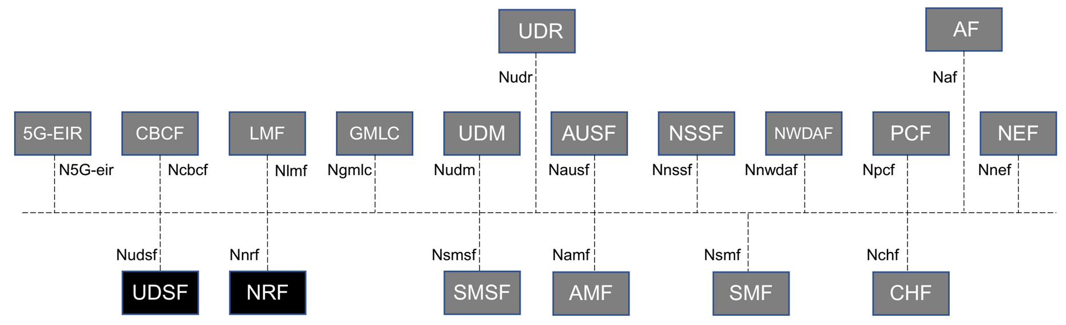
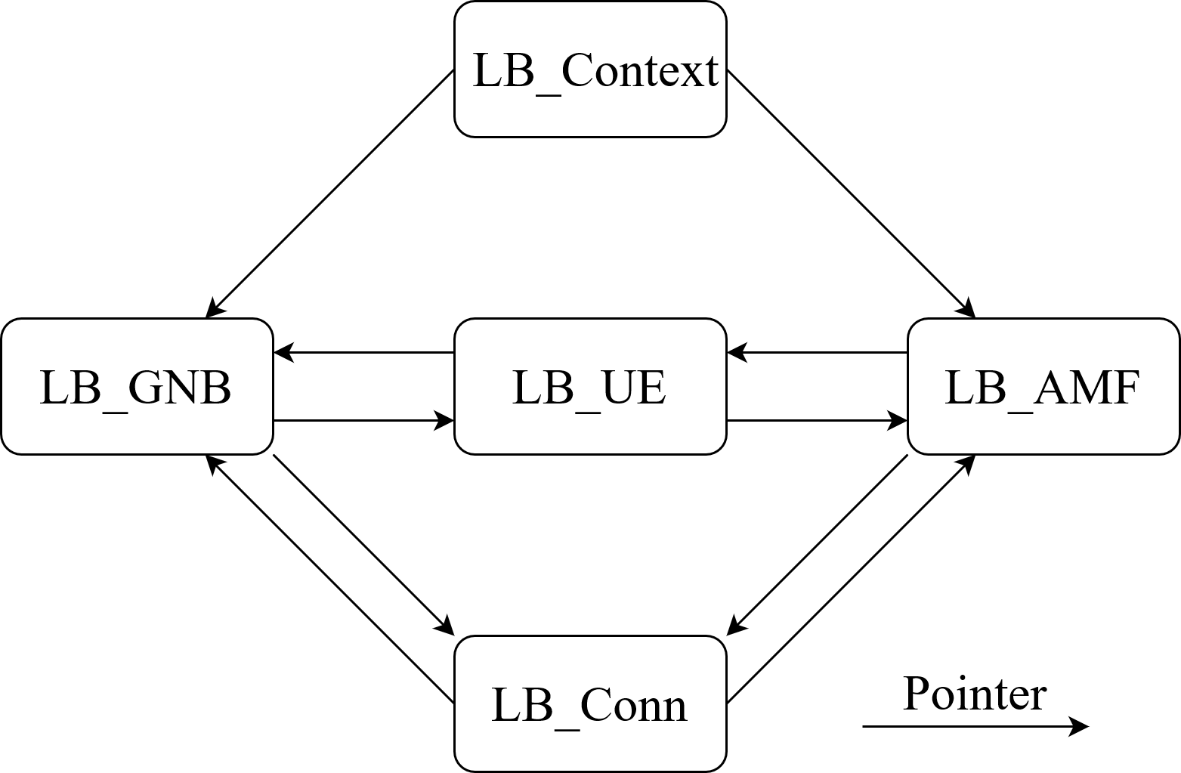
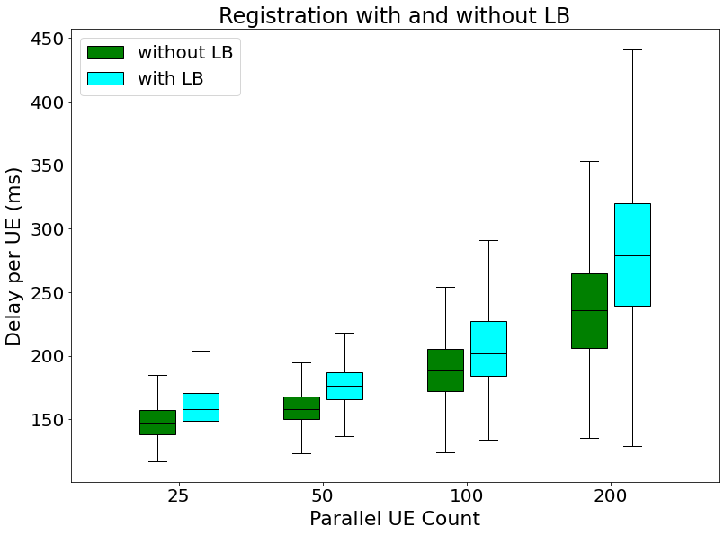
This presentation focuses on the development and testing
of a load balancer meant to interact with free5GC.
Background
Feature implementation
Testing results

Slide 3
Background
Stream Control Transmission Protocol (SCTP)
Kubernetes (K8s)
free5GC

Slide 4
5G – Core (5GC)

Slide 5
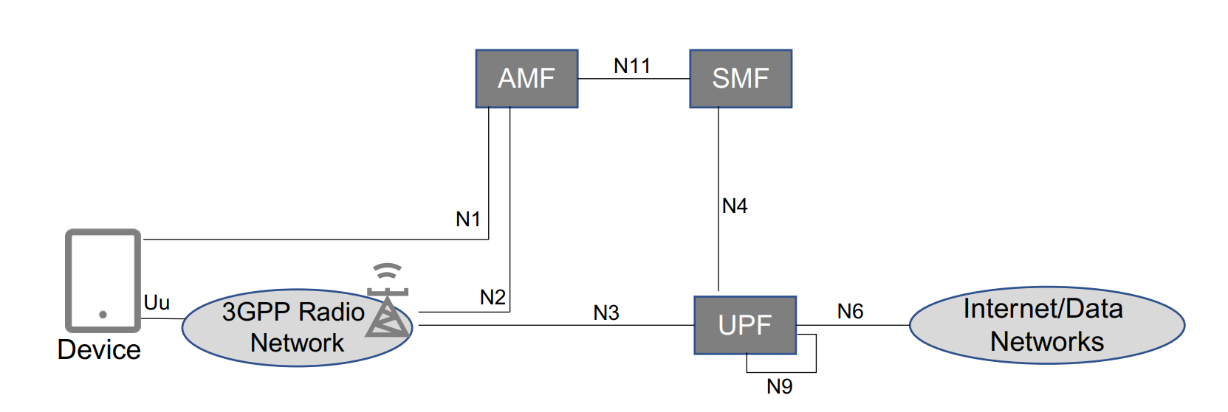
5G – Core (5GC)

Slide 6
Feature implementation

Slide 7
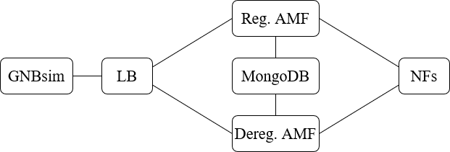
Positioning of the LB

Slide 8
Abstraction of the topology within the LB

Slide 9



UE – based routing
gNB
LB
NGAP Message
Identify RANUENGAPID
Find LB_UE in the UE pool of the LB_GNB linked in the LB_Conn
Inject LB‘s own ID for the UE
LB
AMF
NGAP Message

Slide 10
UE – based routing
AMF
LB
NGAP Message
Identify RANUENGAPID
Find LB_UE in the UE pool of the LB_AMF linked in the LB_Conn
Inject gNB‘s original ID for the UE
LB
gNB
NGAP Message

Slide 11
State – based routing
NAS-Message type has to be identified
only working with plain NAS messages at the moment
only required with two AMF types because the messages are not always sent in order
Sets a flag or initiates the switching of the LB_UE to a LB_AMF of the next phase

Slide 12
Implementation of the load balancing
Number of registered UEs
Relative AMF Capacity
When is the load balancing needed?
Registration of a new UE
UE switching state (registration to deregistration)

Slide 13
Testing results

Slide 14

Registration
25, 50 and 100 parallel Ues:
9-12% added delay per UE
200 parallel Ues:
19.1% added delay per UE
Acceptable

Slide 15
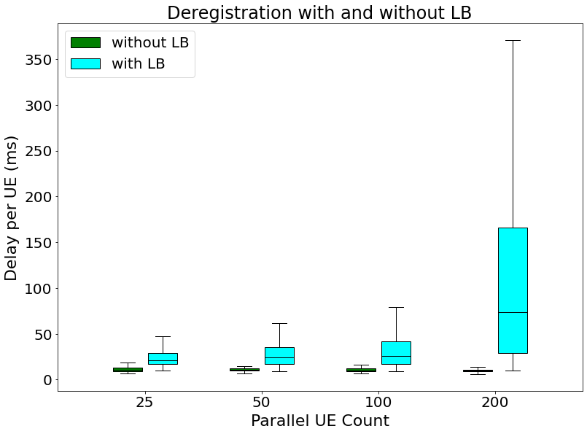

Deregistration
System steady mean delay:
10-12 milliseconds
The LB’s delay:
Unacceptable
(both phases use the same functions)

Slide 16
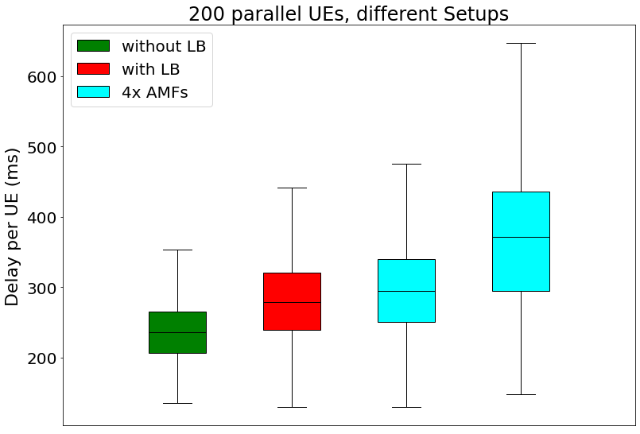
Does the LB prove the concept of reducing the delay per UE by balancing the load over multiple AMFs?

Slide 17
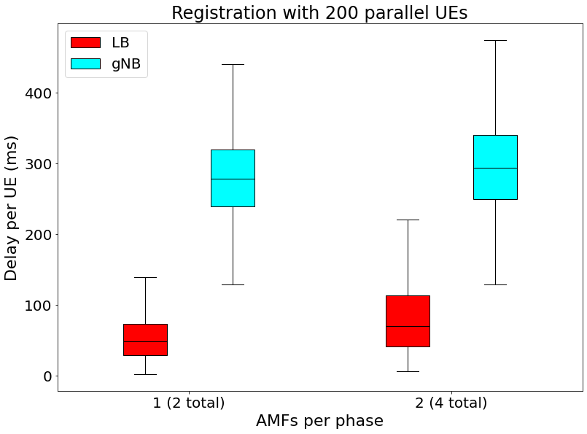
Does the LB prove the concept of reducing the delay per UE by balancing the load over multiple AMFs?
Delay added by the LB:
60.7% (33.7 ms)
Delay added to system:
4.7% (13.3 ms)
Notes:
from 55.5ms to 89.2ms

Slide 18
Conclusion
Working:
SCTP-Connection establishing (listening for gNBs and connecting to AMFs)
NG-Setup
UE-based routing
UE allocation to AMFs
Not working:
Deregistration with 2 or more AMFs per phase
Processing of encrypted NAS-messages
Forwarding messages in order

Slide 19
Future development
Using a database / switching to a stateless architecture
Accepting AMFs during runtime
Rewriting the NGAP-Decoder

Slide 20
Questions?

Slide 21
References
S. Rommer, P. Hedman, M. Olsson, L. Fried, S. Sultana, and C. Mulligan. 5G Core Networks: Powering Digitalization. Elsevier Science amp; Technology, 2019.
The Kubernetes Authors. kubernetes - production-grade container orchestration. 2022. url: https://kubernetes.io/. Accessed: 14.04.2022.
ETSI. TS 123 501 V16.6.0 - 5G; 5G; System architecture for the 5G System (5GS) (3GPP TS 23.501 version 16.6.0 Release 16). Oct. 2020. url: https://www.etsi.org/deliver/etsi_ts/123500_123599/123501/16.06.00_60/ts_123501v160600p.pdf. Accessed: 10.04.2022.
ETSI. TS 138 412 - V15.4.0 - 5G; NG-ran; NG signalling transport. url: https://www.etsi.org/deliver/etsi_ts/138400_138499/138412/15.00.00_60/ts_138412v150000p.pdf. Accessed: 02.03.2022.
free5GC.ofg. What is free5GC? url: https : / / www . free5gc . org/. Accessed:14.04.2022.
P. Natarajan, F. Baker, P. D. Amer, and J. T. Leighton. “SCTP: What, Why, and How.” In: IEEE Internet Computing 13.5 (2009), pp. 81–85. doi: 10.1109/MIC.2009.114.

